Slide 1




Optimising Customer Acquisition and Maximising Lifetime Value
Presented By Team Cobalt

Slide 2




Executive Summary
Situation
Compilication
Solution
Tracking customer acquisition cost (CAC) trends across multiple years
Evaluating changes in CAC as new advertising platforms are introduced
Understanding the impact of different ad channels on overall customer acquisition costs over time.
Steady growth in revenue and orders across the 3 year period
High Customer Acquisition Cost
Decreasing ROAS
Low Customer Retention
Variable Customer Lifespan
Optimising Campaign Timing
Introduce discount offers to increase retention
Optimise high performing channels

Slide 3

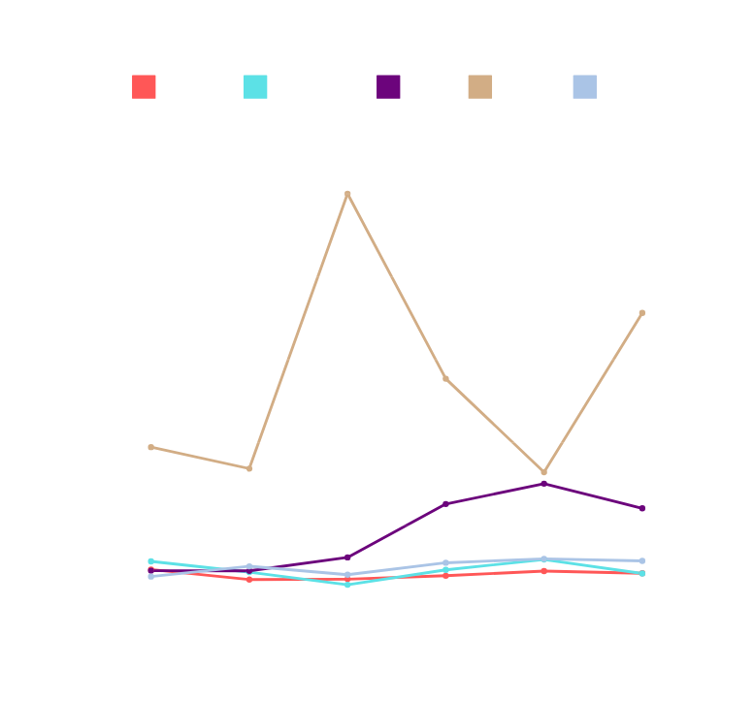
June Leads the CAC race, Rtbhouse and Criteo Set the Pace
CAC Over Year (£)
CAC by Platform in 2022 (£)
Best time for CAC: June
Worst time for CAC: Black Friday
Best performing platforms: Rtbhouse and Criteo
Missed potential of extra £120k revenue

Slide 4
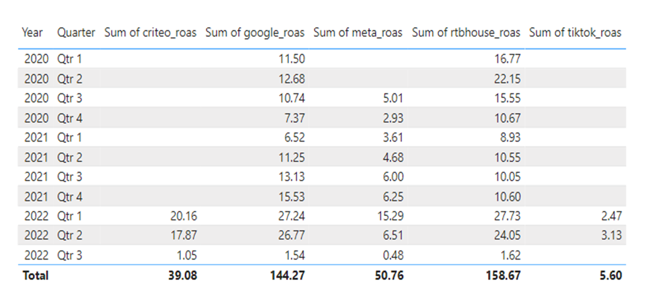
Q1 and Q2 with the highest ROAS so far in 2022
Decline in ROAS on all Platforms in July 2022

Slide 5
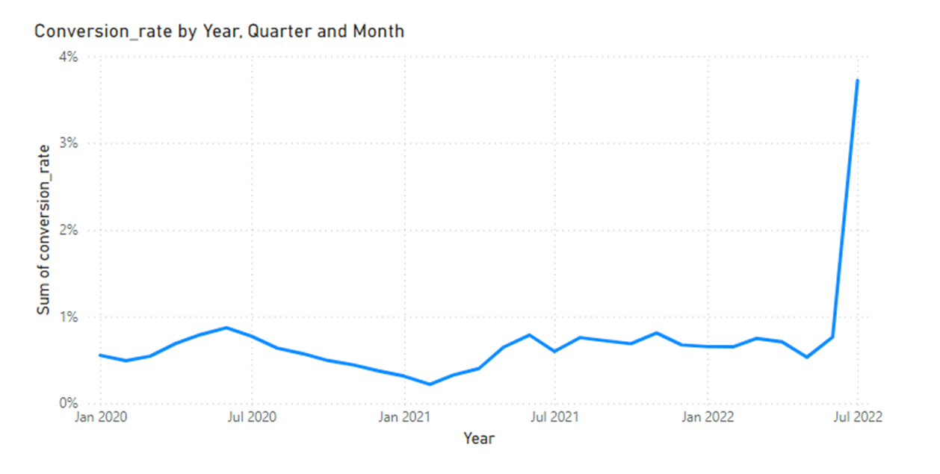
More Customers converted towards the end of Q2 and beginning of Q3 of 2022
Highest Conversion rate of 3.7% In early July 2022

Slide 6
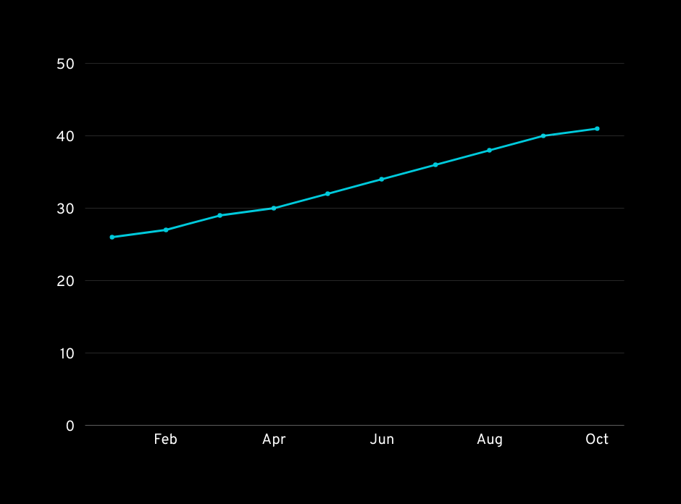
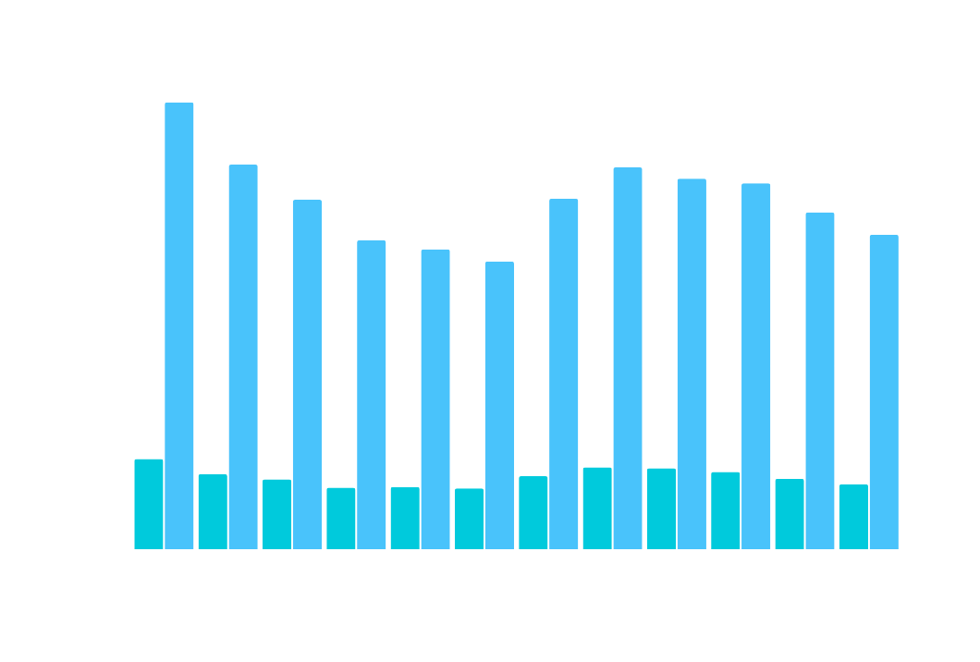
Average Lifespan increasing steadily
January and Late Summer are the best times to acquire customers
Lifepsan (days)
Lifepsan (days)
Current average lifespan of 41 days
Customer Lifespan by month of acquisition

Slide 7
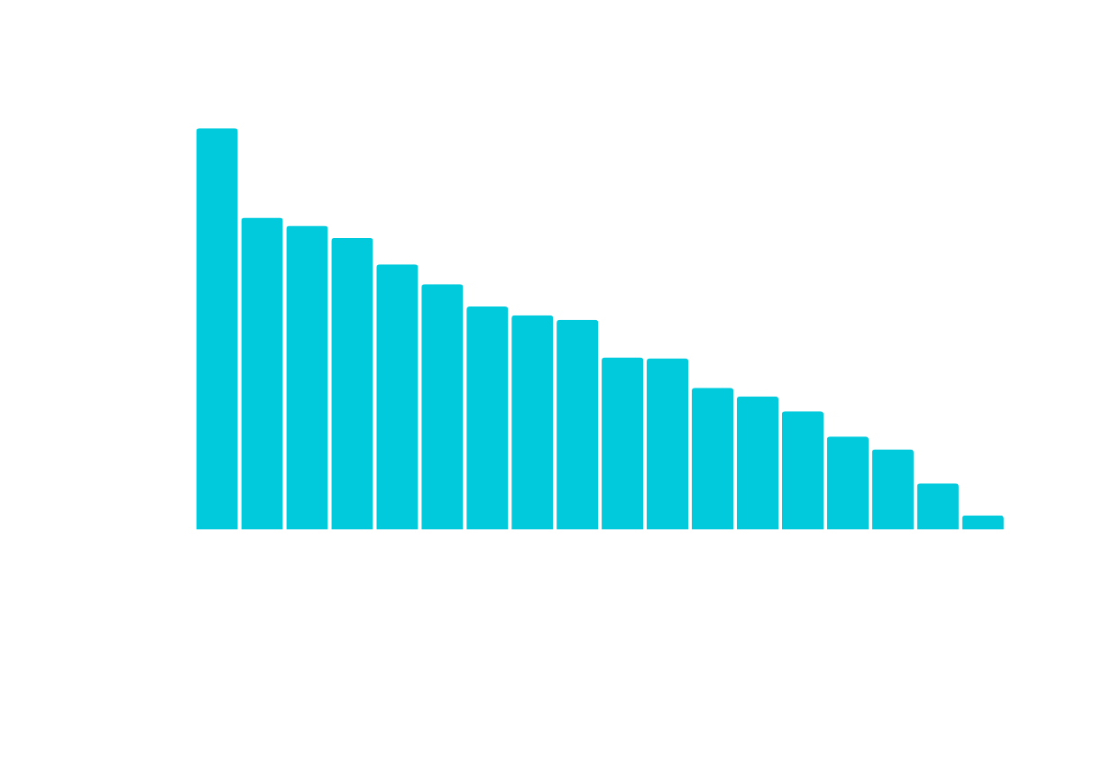
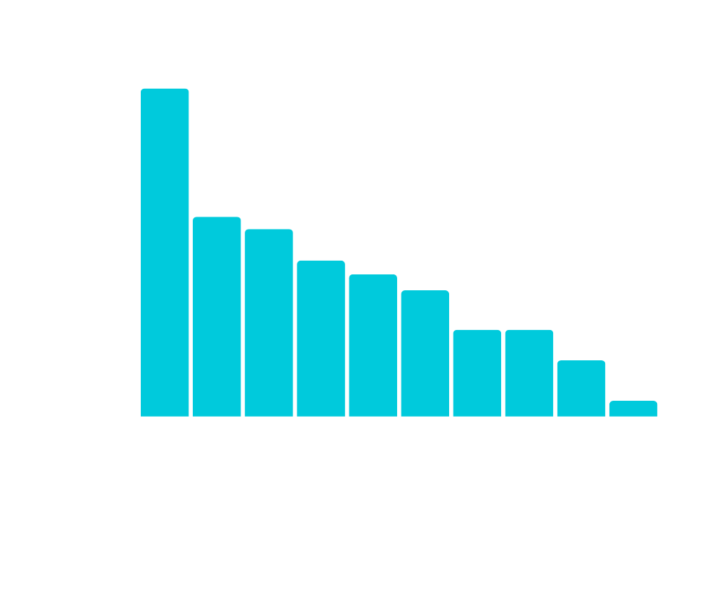
Lifetime Value from first contact
Targeted emails are performing best. Increase the audience to increase sales
Source
Medium
System mail & email generate highest lifetime value customers.
RTBHouse best performing among paid advertising
The CRM is working really well, we need to push for opting in.

Slide 8
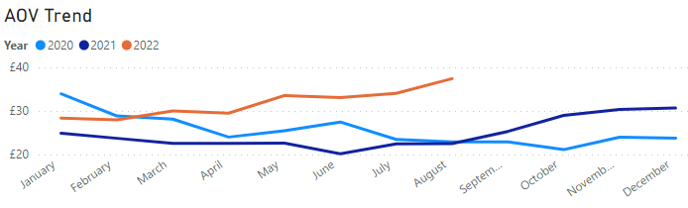
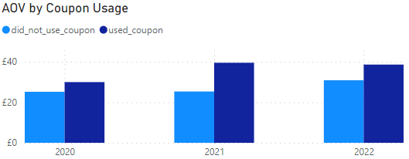
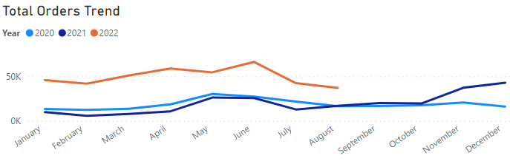
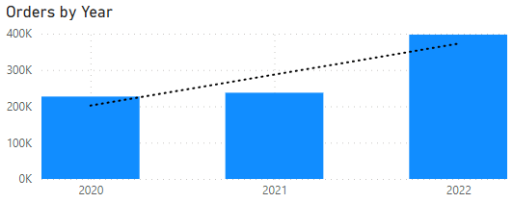
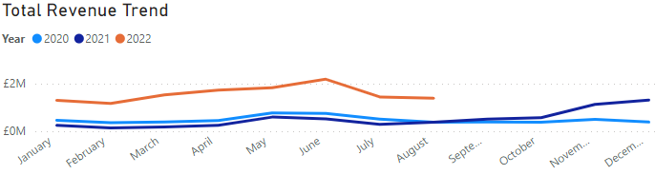
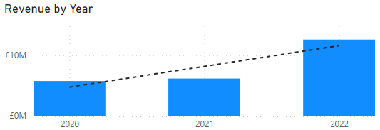
Steady growth recorded in Yearly Orders and Revenue.
Customers have purchased more in 2022, with 4 months till year end.

Slide 9
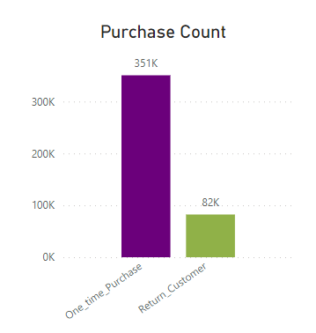
Customer Retention 14% Lower than Industry Average
Only 19% of our customers return, lower than industry average of 33% for fashion.

Slide 10

Increase ad spend in June and reduce during high CAC periods Impact: Lowers overall CAC, allowing for investment elsewhere | Adjust strategies for Q3 by reallocating budget to higher conversion channels Impact: Increased ROAS and ensures consistent conversion rate by optimising our budget use
Focus on high-performing channels, expanding efforts on system mail and targeted email campaigns Impact: Increases customer LTV by using effective channels | Offer discounts to increase repeat purchases Impact: Increases retention and recurring revenue, improving overall LTV
Final Insights

